Slide 1
Comparison with QM
New sample with old macro

Slide 2
Comparison with QM
New macro to compare methods

Slide 3
Comparison with QM
Heavy Ion Overlay

Slide 4
Comparison with QM
Heavy Ion Overlay (Smeared by MC)

Slide 5
Changes from Quark Matter
Events with 2 D0s were not treated properly
The MC D0 Jet Spectra was not identical to the QM method
Ensured that the centrality distribution of overlaid events doesn’t change from data
DCA Cuts were not used on the simulated tracks. I think they should be.
The hadronic correction code had a bug.
Best detector level track → Matched to generated track (This hampers the D0 resolution, and therefore, jet pT)

Slide 6
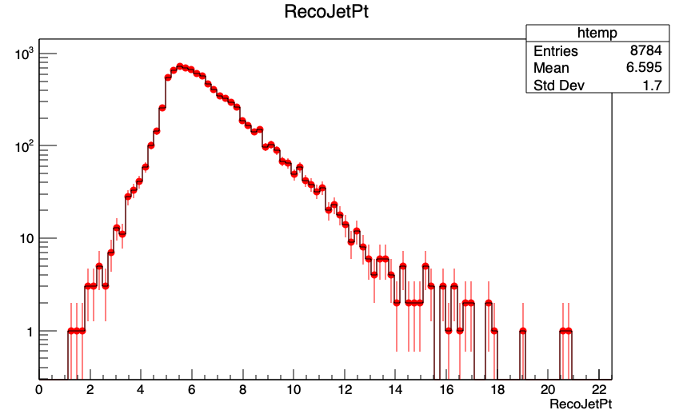
New RCP
DCA fixed in QM method
Tower matching criteria fixed for D0 daughters

Slide 7
New RCP
1. QM macros and the old macros yield the same results more or less

Slide 8

New RCP
1. QM, old, and HI macros yield the same results more or less
Almost similar $δp_{T}$ distributions

Slide 9
New RCP
1. QM macros and the old macros yield the same results more or less
In the new macros to implement superiterations, I have cuts based on value of z for reco.
The QM analysis did not have cuts based on z.

Slide 10
Cross Closure:
Response made from QM Method → Unfolding the HI
There are changes at the level of the response matrix then

Slide 11
Comparing pT smear from QM and HI

Slide 12
Quantifying the pT smear from QM

Slide 13
Heavy Ion Overlay (Smeared by MC)

Slide 14
Closure 2D

Slide 15
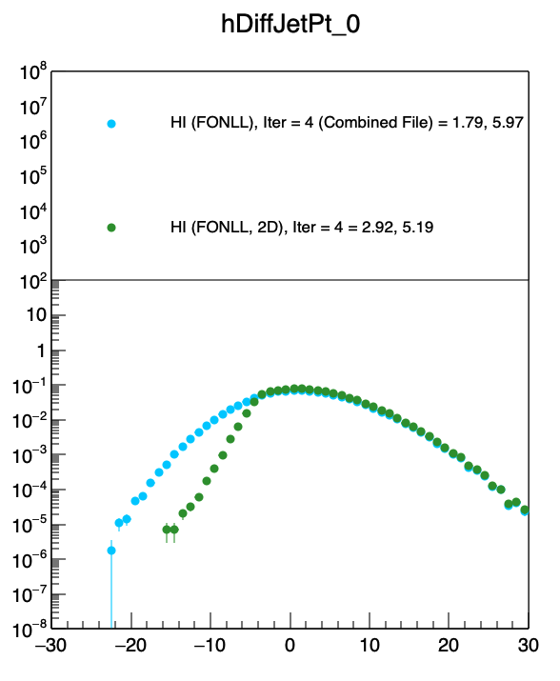
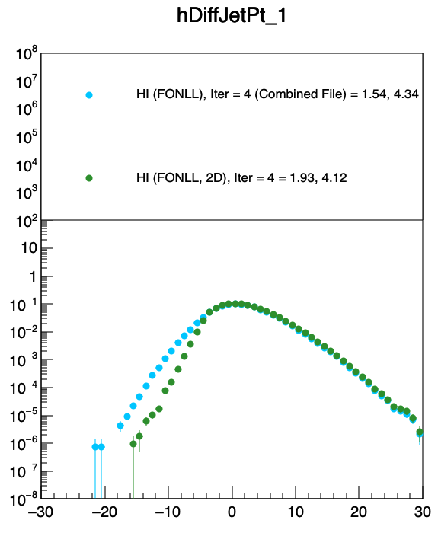
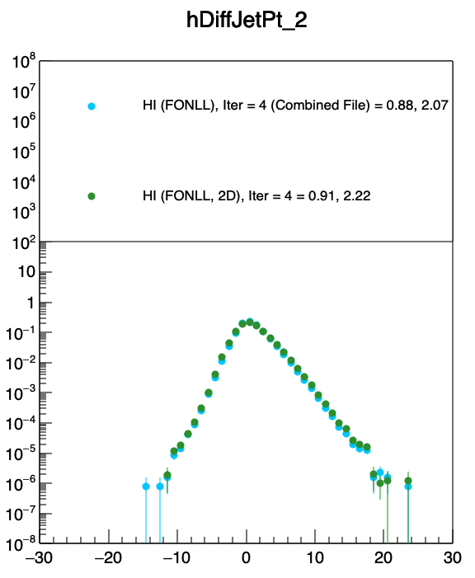
Applying to Data

Slide 16
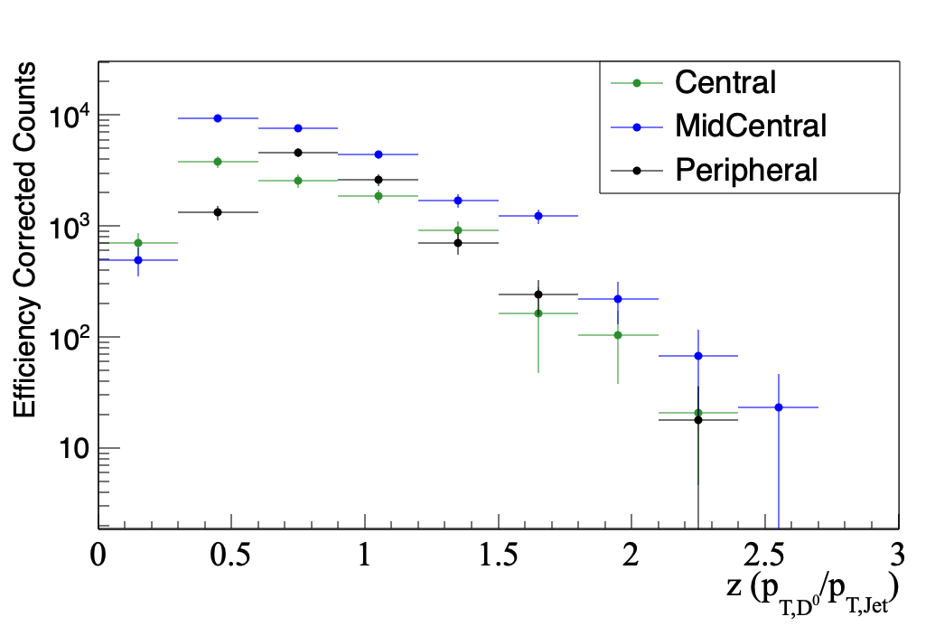
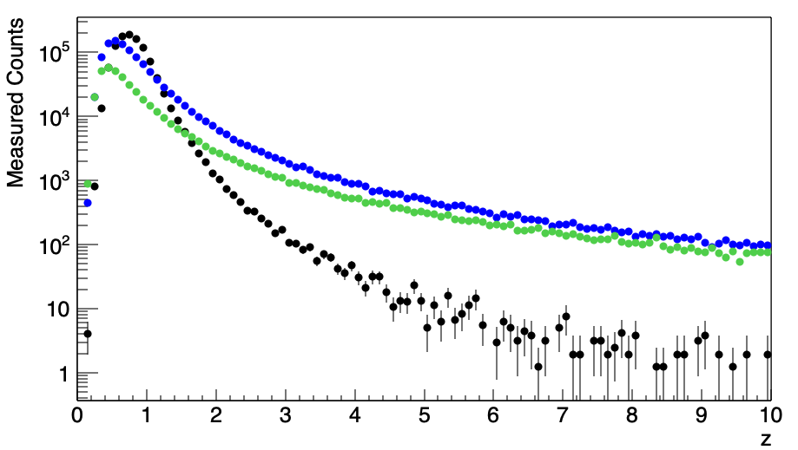
Data
Heavy Ion Simulation

Slide 17
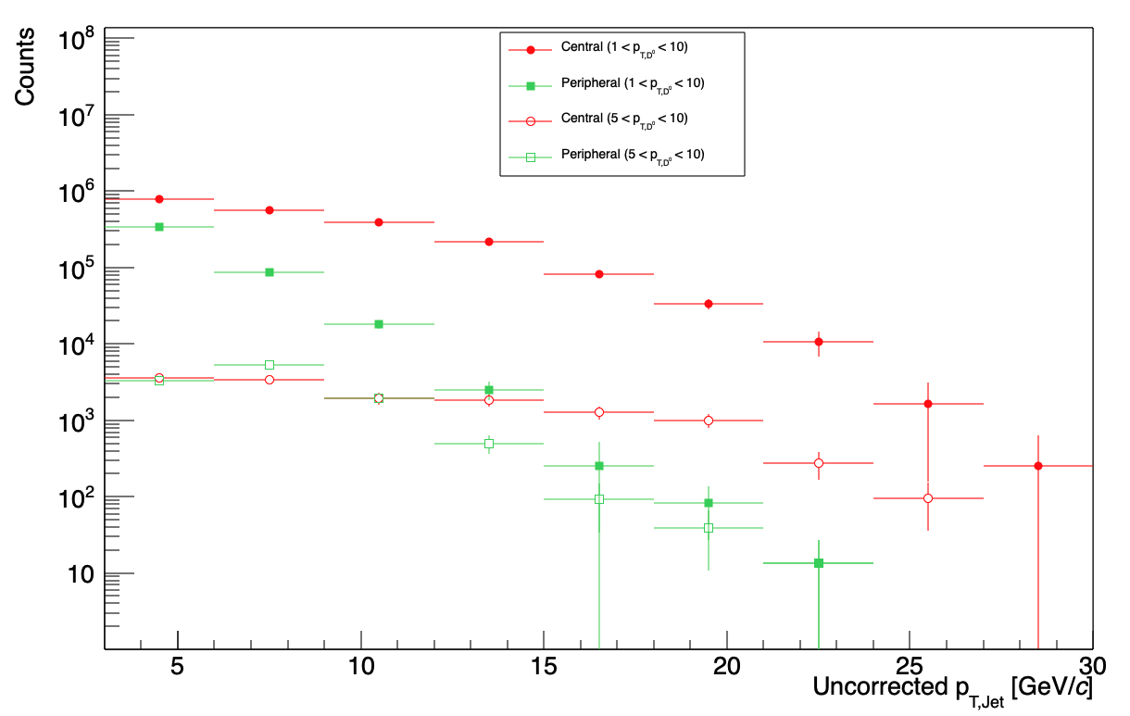
sPlot

Slide 18
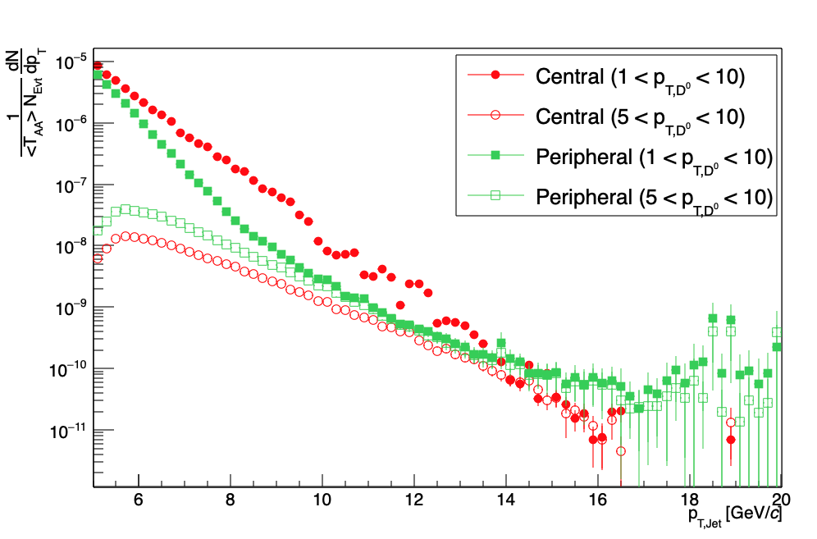
Unfolded distributions from the same macro for the different D0 pT ranges

Slide 19
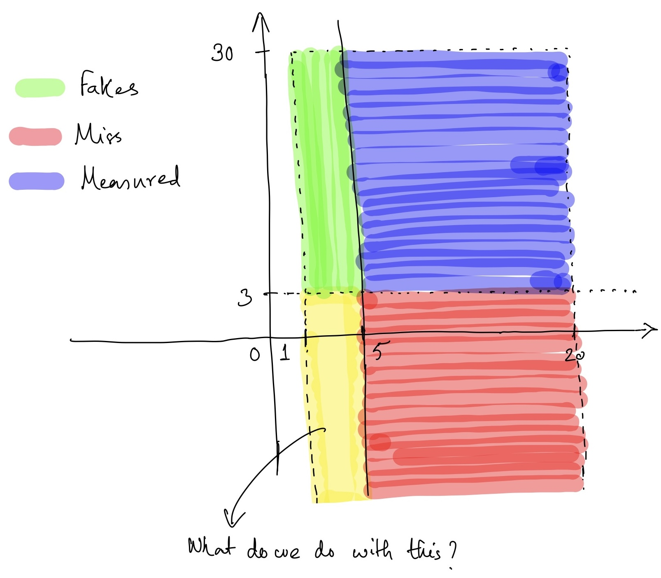
Reco
Current Definition:
5 < MC Jet pT < 20
3 < Reco Jet pT < 30
1 < D0 pT < 10
Gen

Slide 20
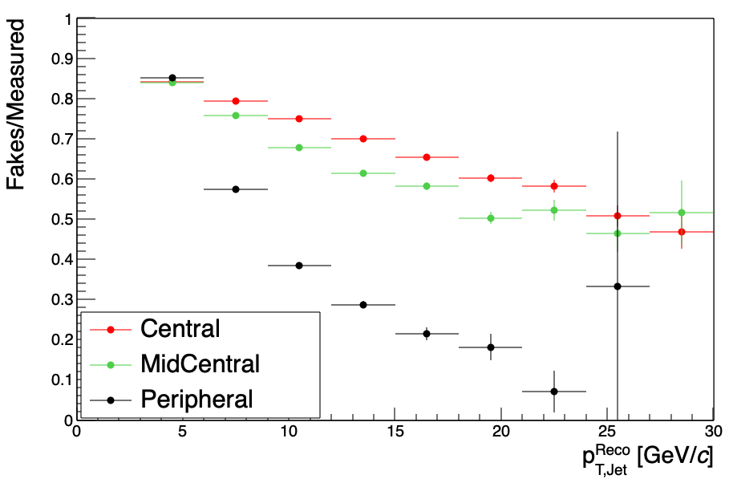
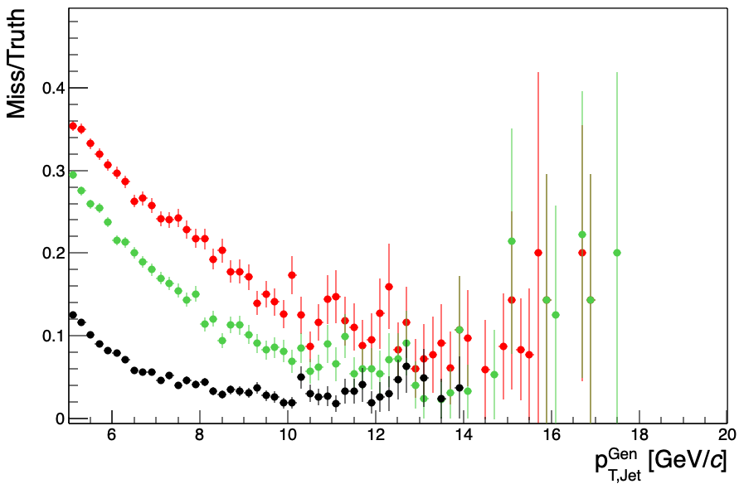
Fakes
Miss
/Users/diptanilroy/.ssh/config
Current sample is made of PYTHIA events with jet pt > 5 GeV
Need HI Overlay with regular PYTHIA events (?)

Slide 21
PYTHIA Sample with D0 + Jets > 1 GeV
Chi2 after Folding in Data Uncertainty
Combined Reduced Chi2 minima at < 15 SI

Slide 22
Closure

Slide 23
Data Unfolding with Data Z

Slide 24
Data Unfolding with Data Pt and Data Z

Slide 25
Data Unfolding with SI for minimum Chi2
RecoJetPt > 0

Slide 26
Data Unfolding With Non-Closures Folded In
Non-Closure of Flat Distribution unfolding PYTHIA
RecoJetPt > 1

Slide 27
Data Unfolding without Non-Closures Folded In
RecoJetPt > 1

Slide 28
Data Unfolding With Non-Closures Folded In
Non-Closure of Flat Distribution unfolding (1-z^3)
RecoJetPt > 1

Slide 29
Using PYTHIA BBBar as a prior

Slide 30
Data Unfolding With PYTHIA HardQCD and PYTHIA BBBar
RecoJetPt > 1

Slide 31
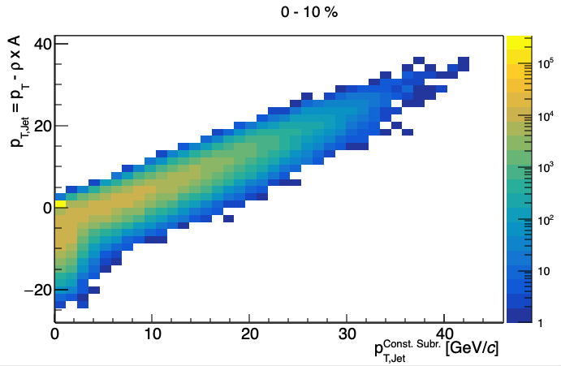
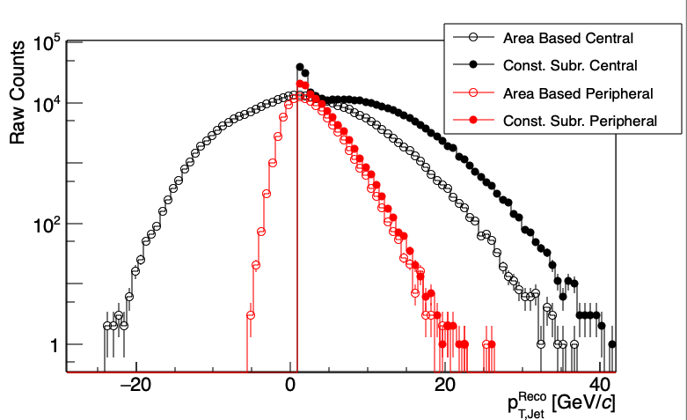
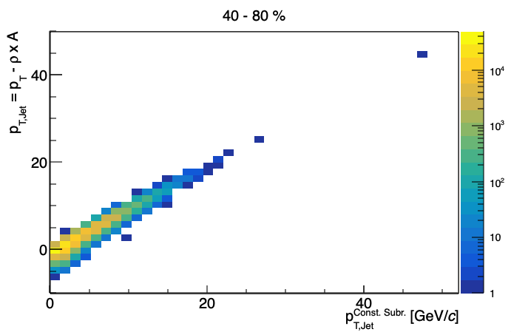
Background subtraction using constituent subtraction
1 < p_{T, D0 Candidate} GeV/c < 10

Slide 32
Closure with D0 pT > 5 GeV/c and jet pT > 5 GeV/c using constituent subtraction
Jet pT
Closure
Jet Z
Closure

Slide 33
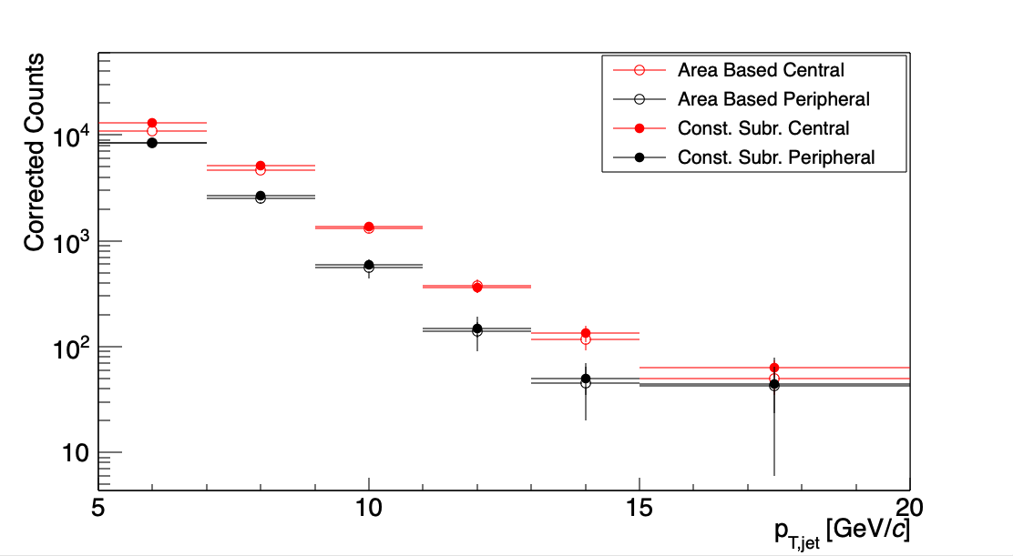
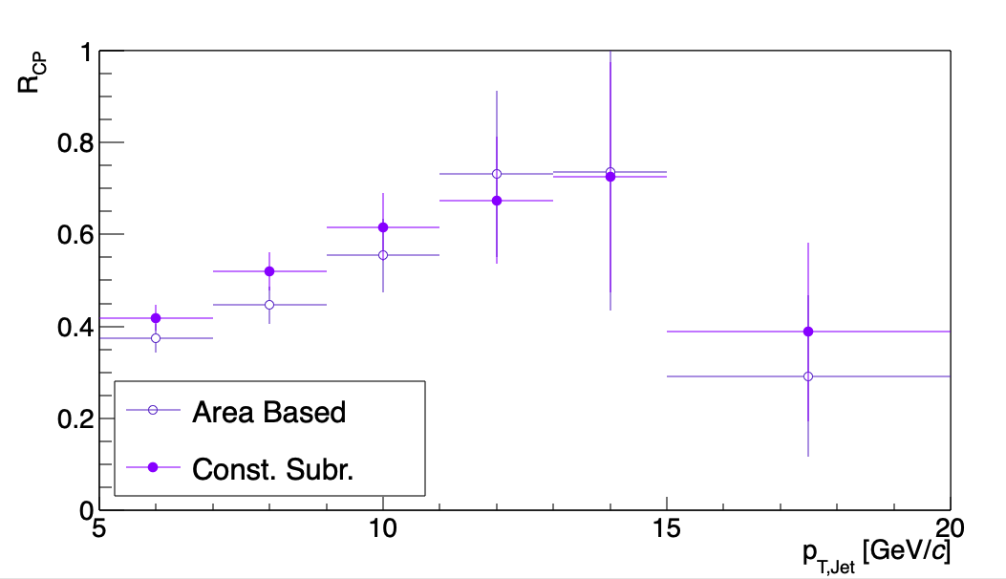
Unfolding with D0 pT > 5 GeV/c and jet pT > 5 GeV/c using constituent subtraction
Small differences (Need to dig in)

Slide 34
Unfolding with D0 pT > 5 GeV/c and jet pT > 5 GeV/c using constituent subtraction
Criteria | Area Based | Constituent Subtraction
Gen D0 pT [GeV/c] | [5, 10] | [5, 10]
Reco D0 pT [GeV/c] | [5, 10] | [5, 10]
Gen Jet pT [GeV/c] | [5, 20] | [5, 20]
Reco Jet pT [GeV/c] | [3, 30] | [5, 50]
Reco Misses Jet pT [GeV/c] | (-inf, 3) & (30, inf) | None
Reco Misses Jet Eta | |eta| > 0.6 | |eta| > 0.6

Slide 35
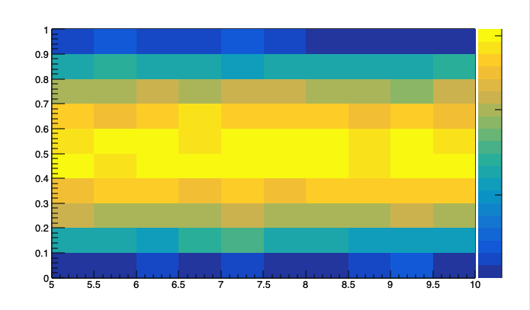
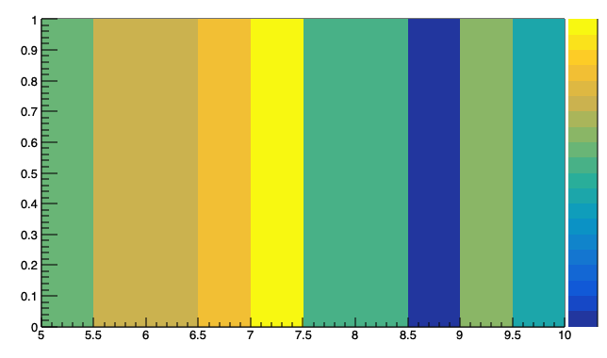
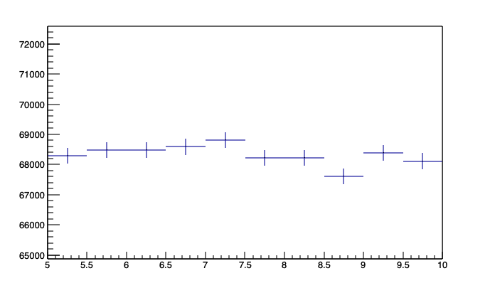
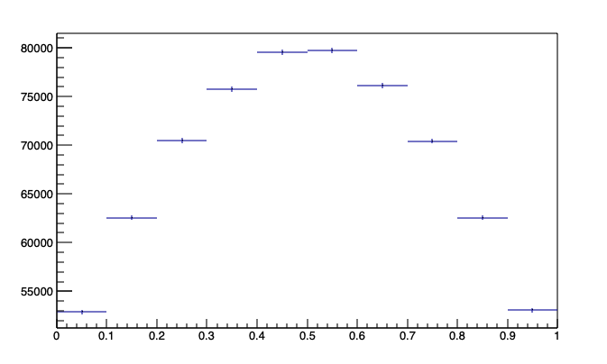
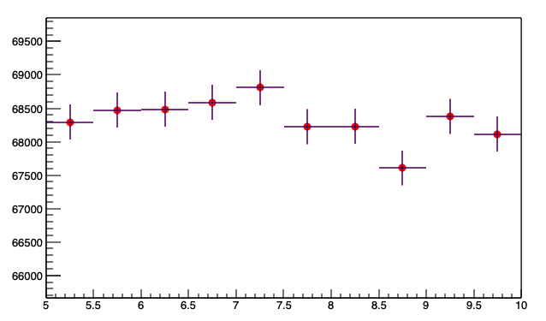
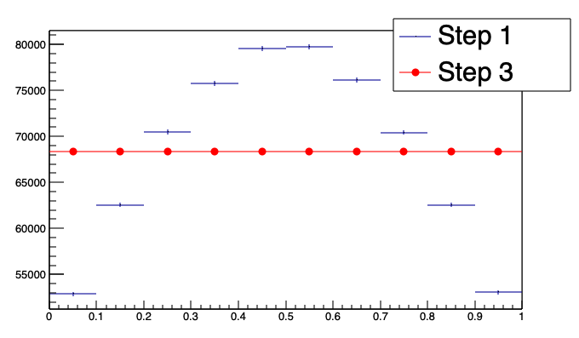
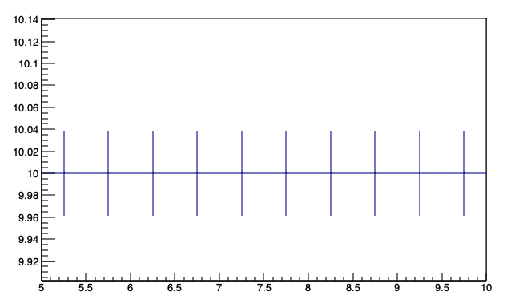
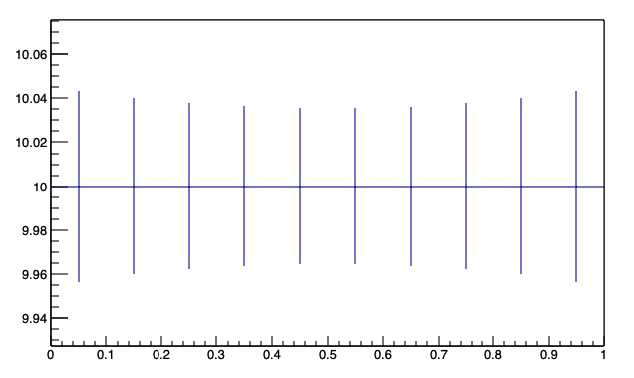
Steps To Change Z Distribution
Step 1
Step 3
X
Y
Weight (X,Y) = 1.0
Step 2
X
Y
X
Y
If there’s no empty bins, this is a straightforward process.
But ALAS!

Slide 36
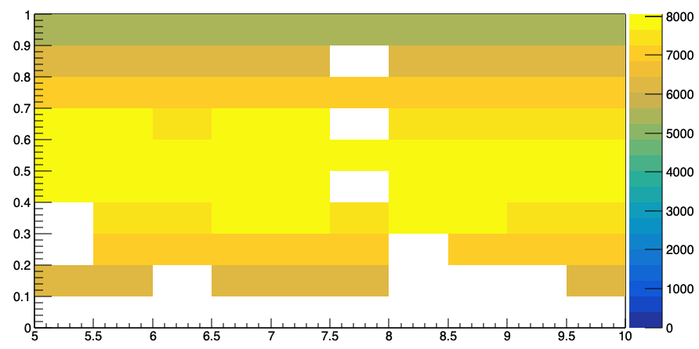
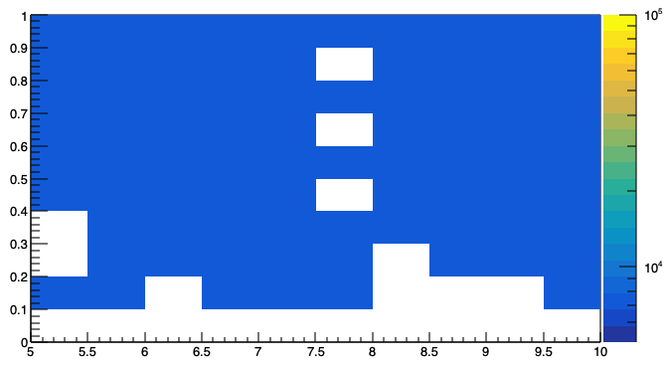
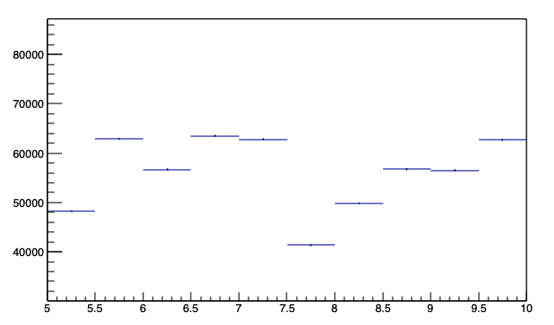
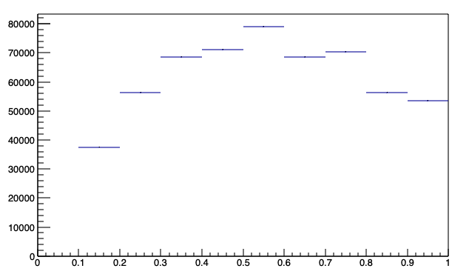
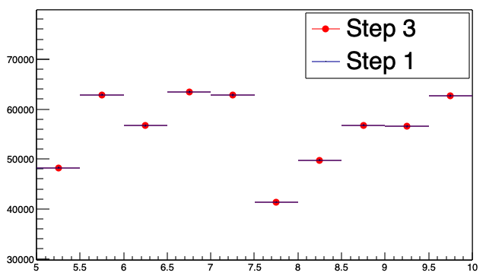
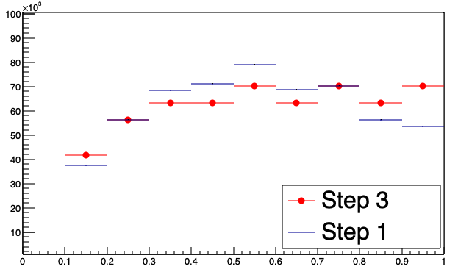
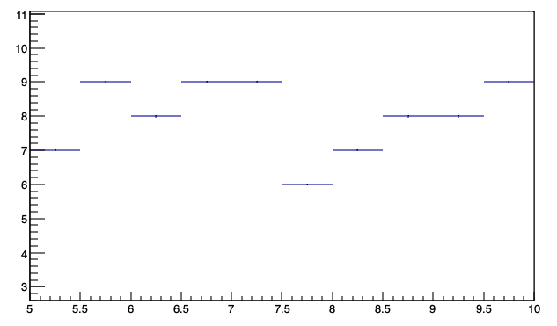
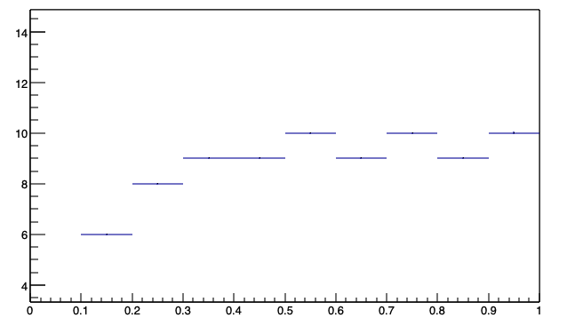
Steps To Change Z Distribution where bins are empty
Step 1
Step 3
X
Y
Weight (pT, Z) = 1.0
Step 2
X
Y
X
Y
This is more in line with what we see in experiment.
But ALAS!

Slide 37
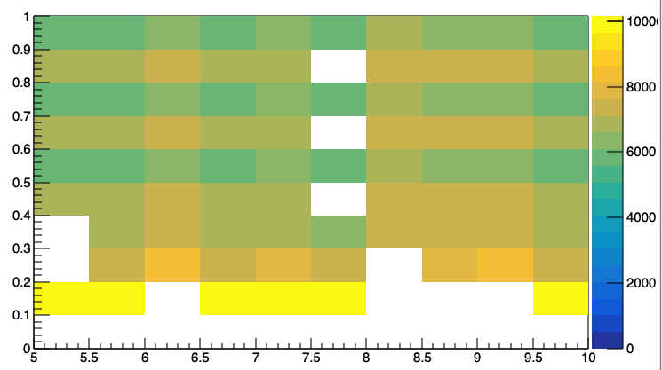
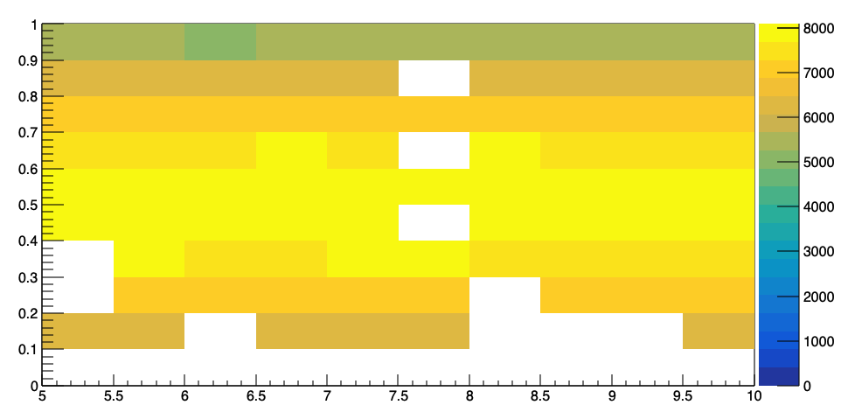
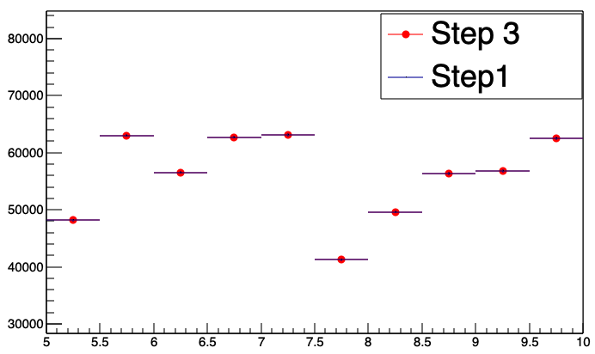
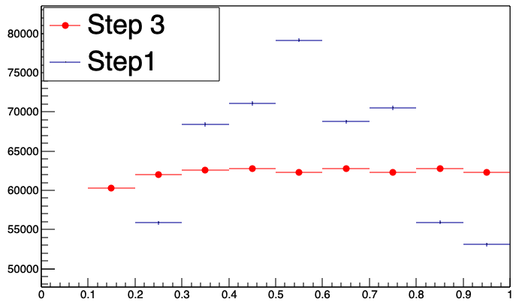
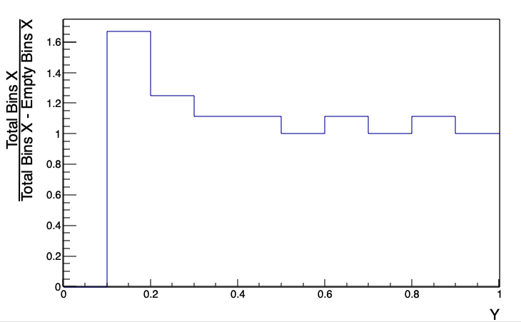
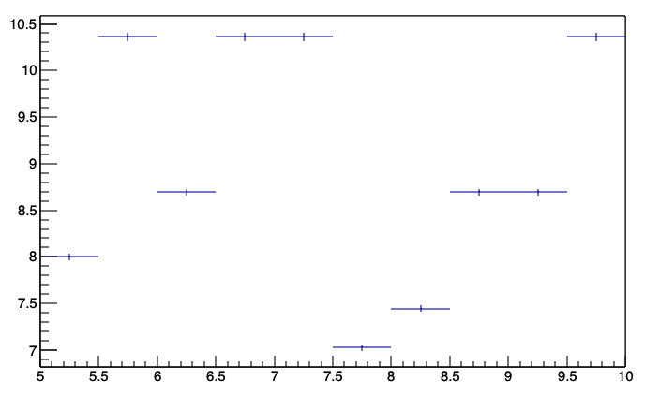
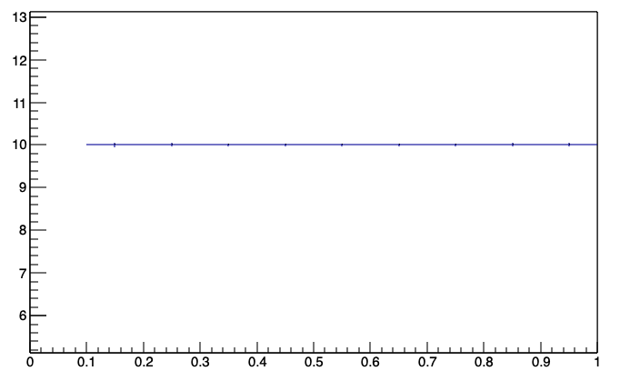
Steps To Change Z Distribution where bins are empty
Step 3
Step 1
X
Y
X
Y
Weight (pT, Z) = 1.0 times
Step 2
X
Y

